Slide 1
Dan Abernathy Citibike Station Overview
File created on: 7/17/19 4:02:11 PM EDT
By Dan Abernathy

Slide 2
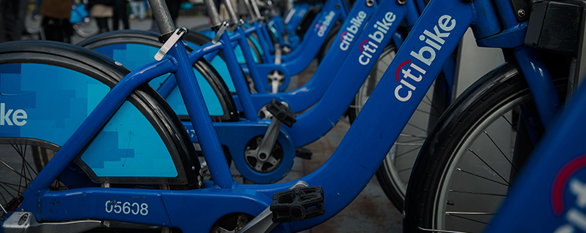
MOST POPULAR STATIONS DASHBOARD

Slide 3
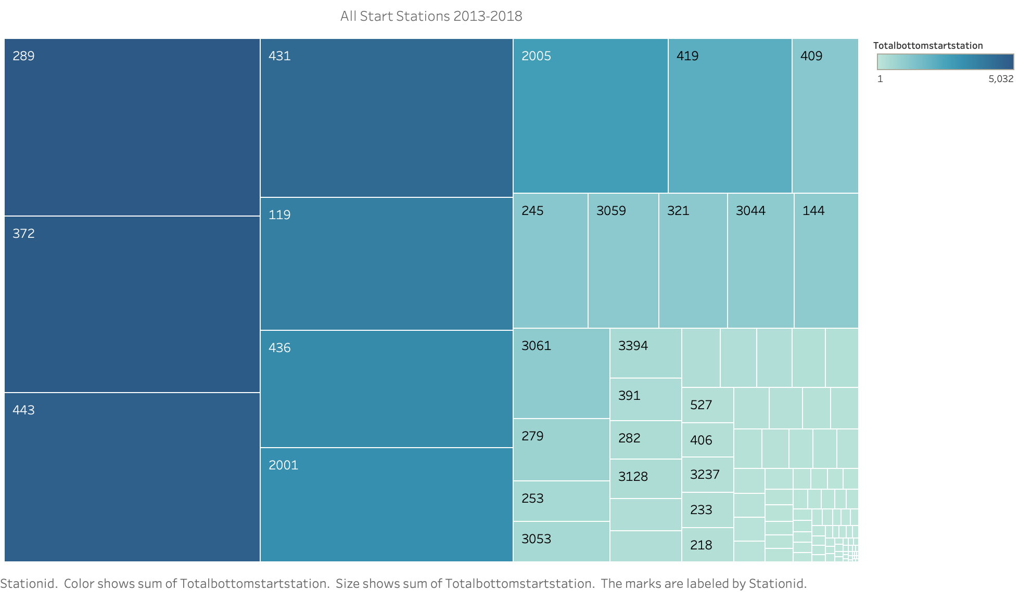

Slide 4
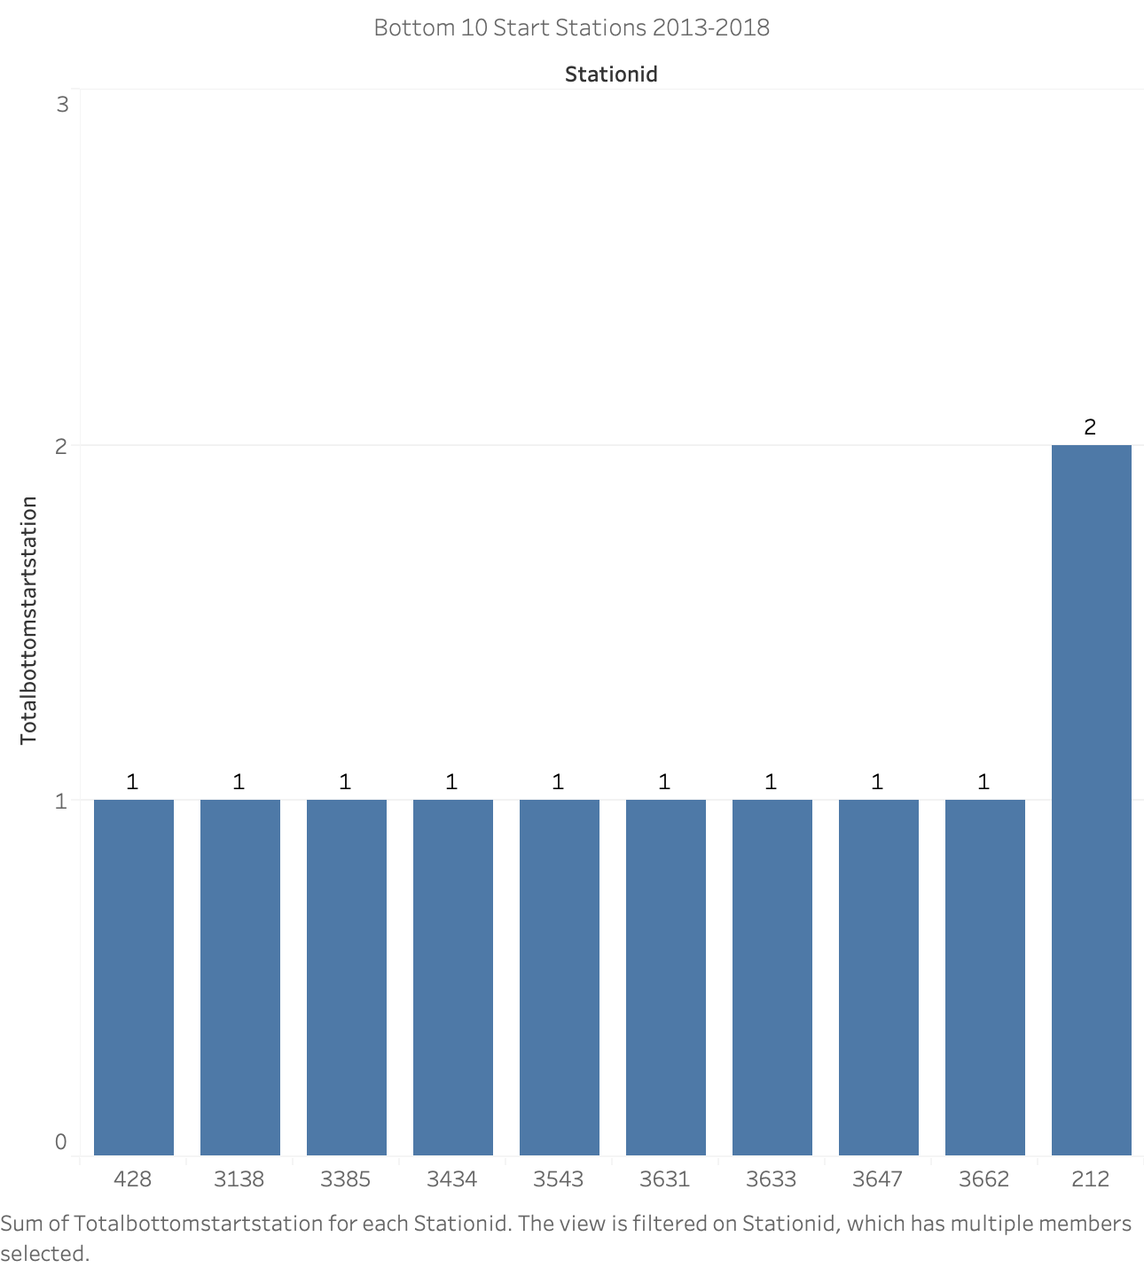

Slide 5
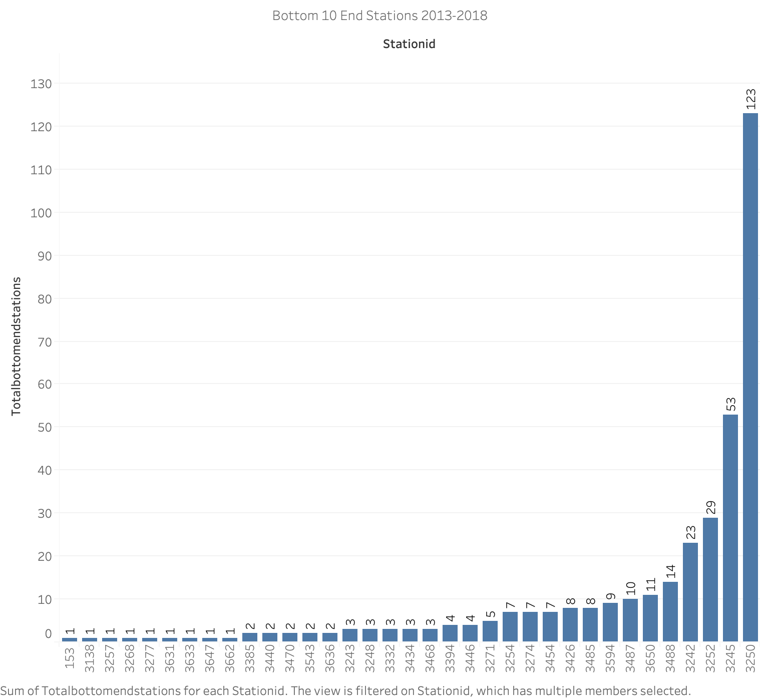

Slide 6
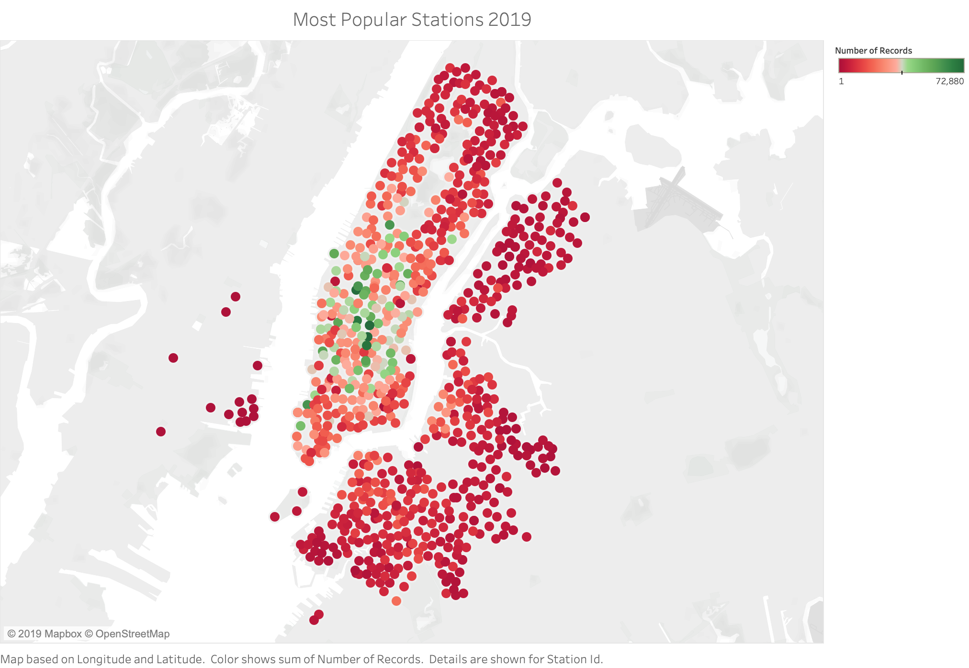

Slide 7
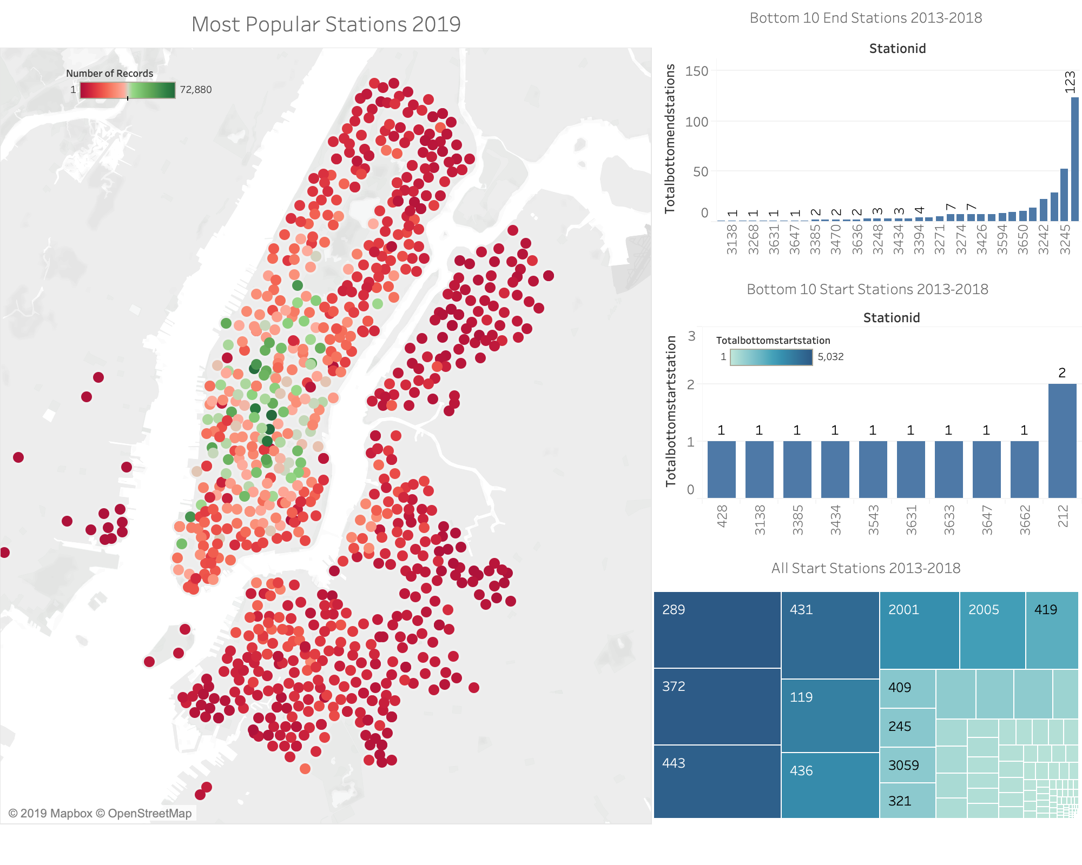
CONCLUSIONS:
The 300’s through 500’s Identified station numbers are most popular locations most likely because they are on the island of Manhattan and are in proximity to tourist attractions
Below south of Central Park and above the financial district of Manhattan are the most frequented stations
In immediate proximity to the most desirable locations to either shop, tour, eat, and play, seek entertainment, bars
Concentration of most popular stations in Chelsea, SOHO, and the popular bars/restaurants just south of SOHO is where the popular stations appear to fan out and decentralize away from 5th avenue
Appears that the popularity of Citi bike usage is 10x higher in the bottom/middle of the island of Manhattan than the northern tip of the same island Popularity of stations falls as one leaves the island of Manhattan

Slide 8

GENDER PREFERENCE DASHBOARD

Slide 9
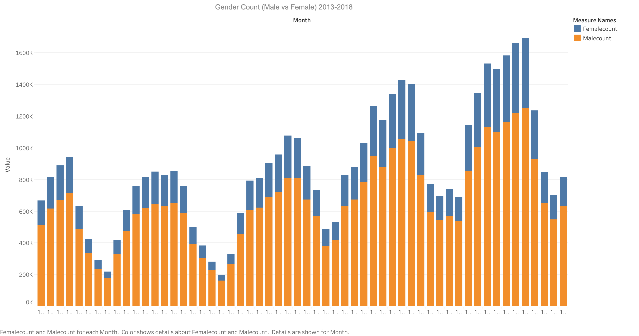

Slide 10
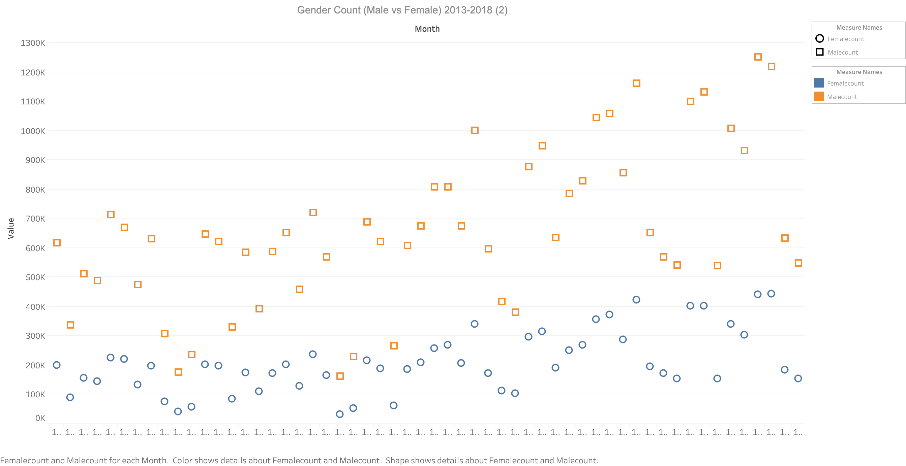

Slide 11
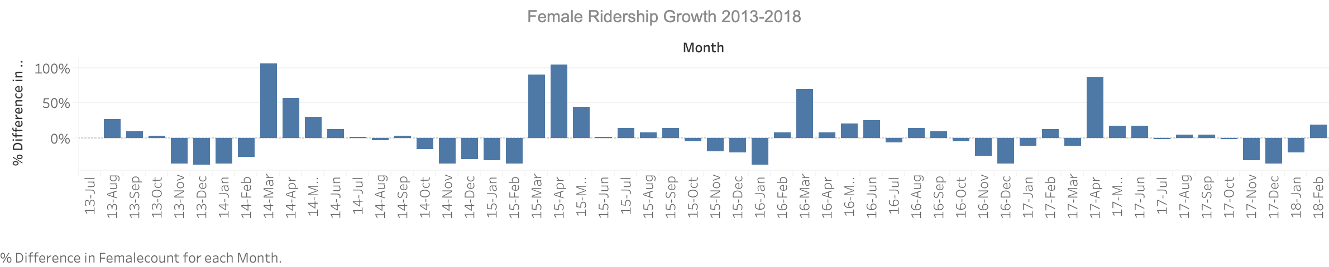

Slide 12
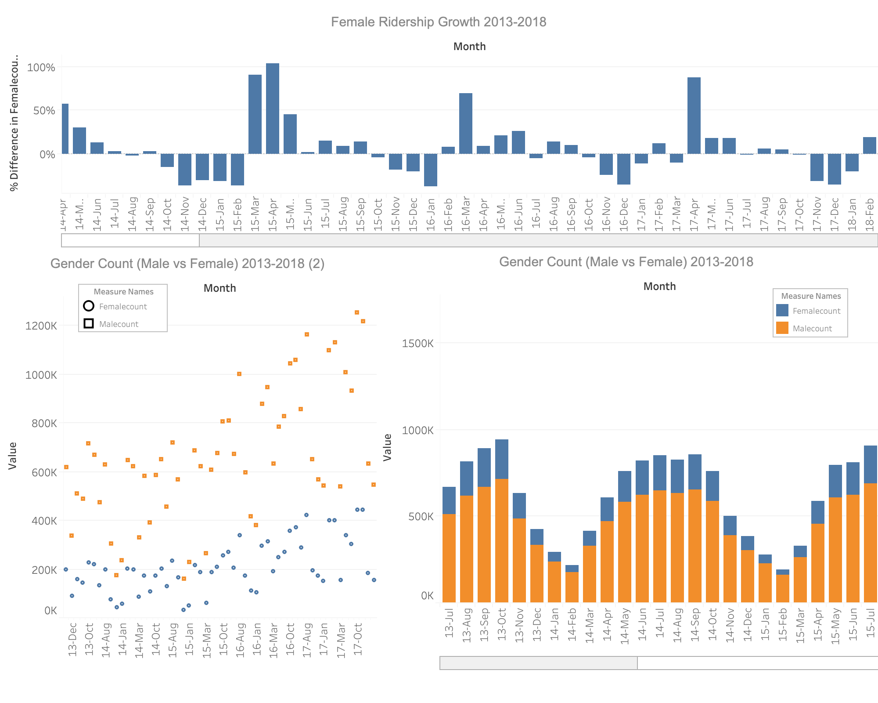
CONCLUSIONS:
Men ride Citibikes more than women
When women do ride it is highest in the month of March/April
Men ride the Citibike more than twice as much as women
Highest amount of male riders is from March to November

Slide 13
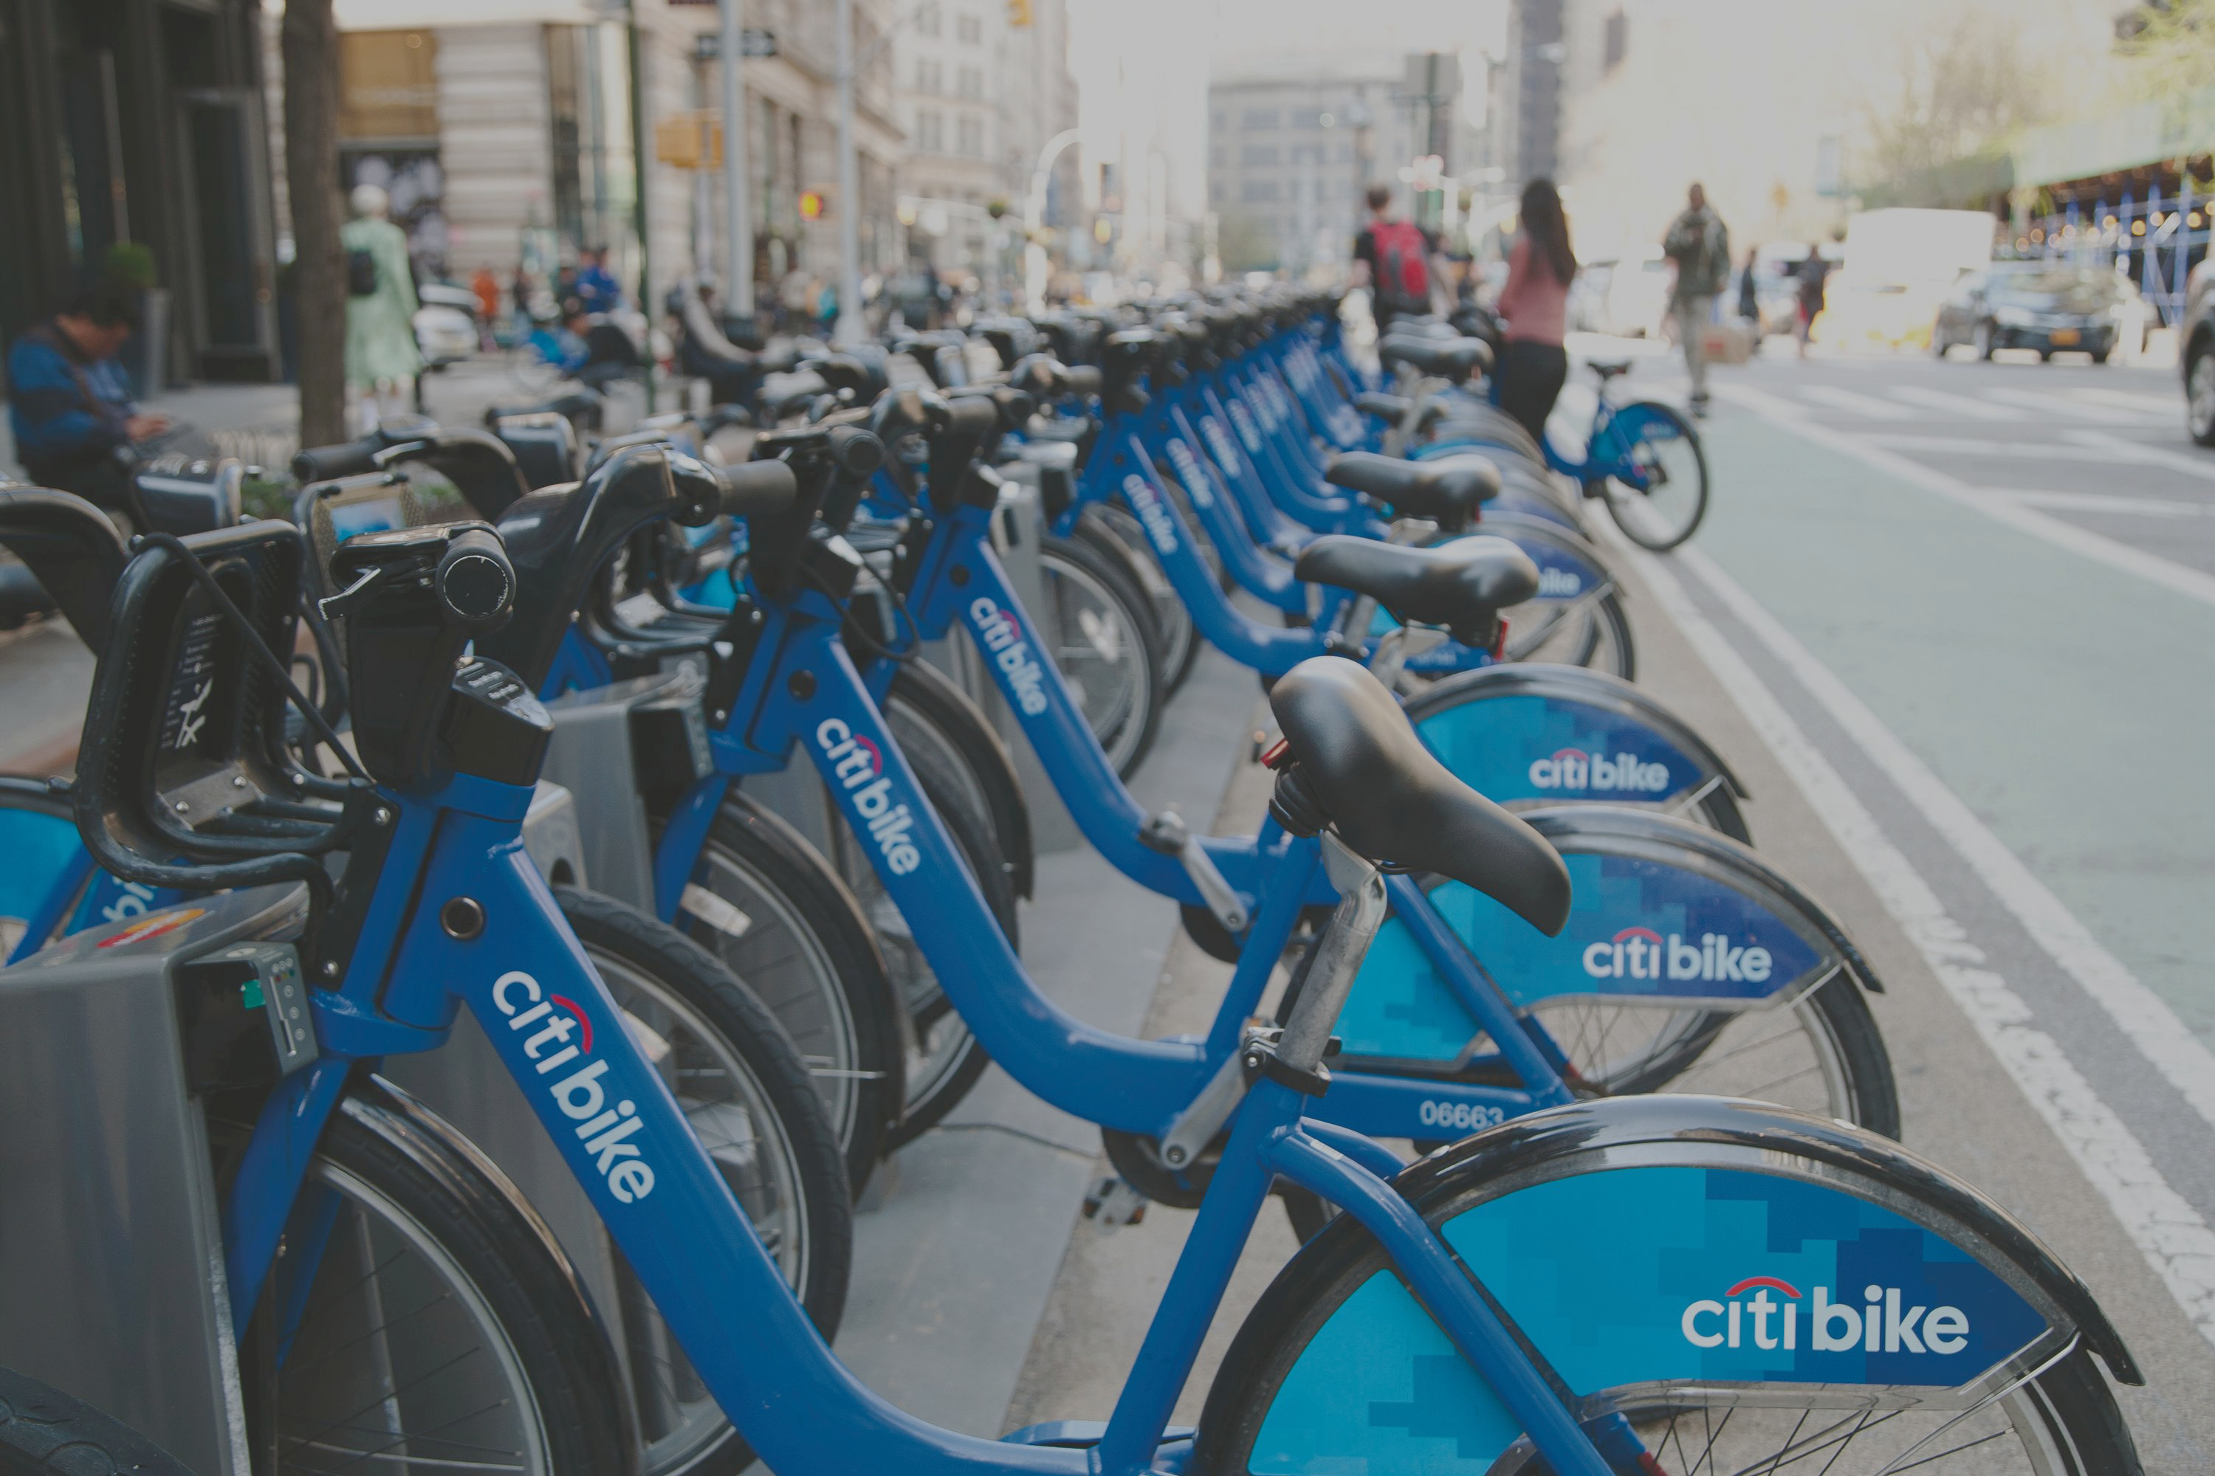
THANK YOU
File created on: 7/17/19 4:02:11 PM EDT
By Dan Abernathy

